Slide 1
Weekly Report
Dian Hanifudin Subhi

Slide 2
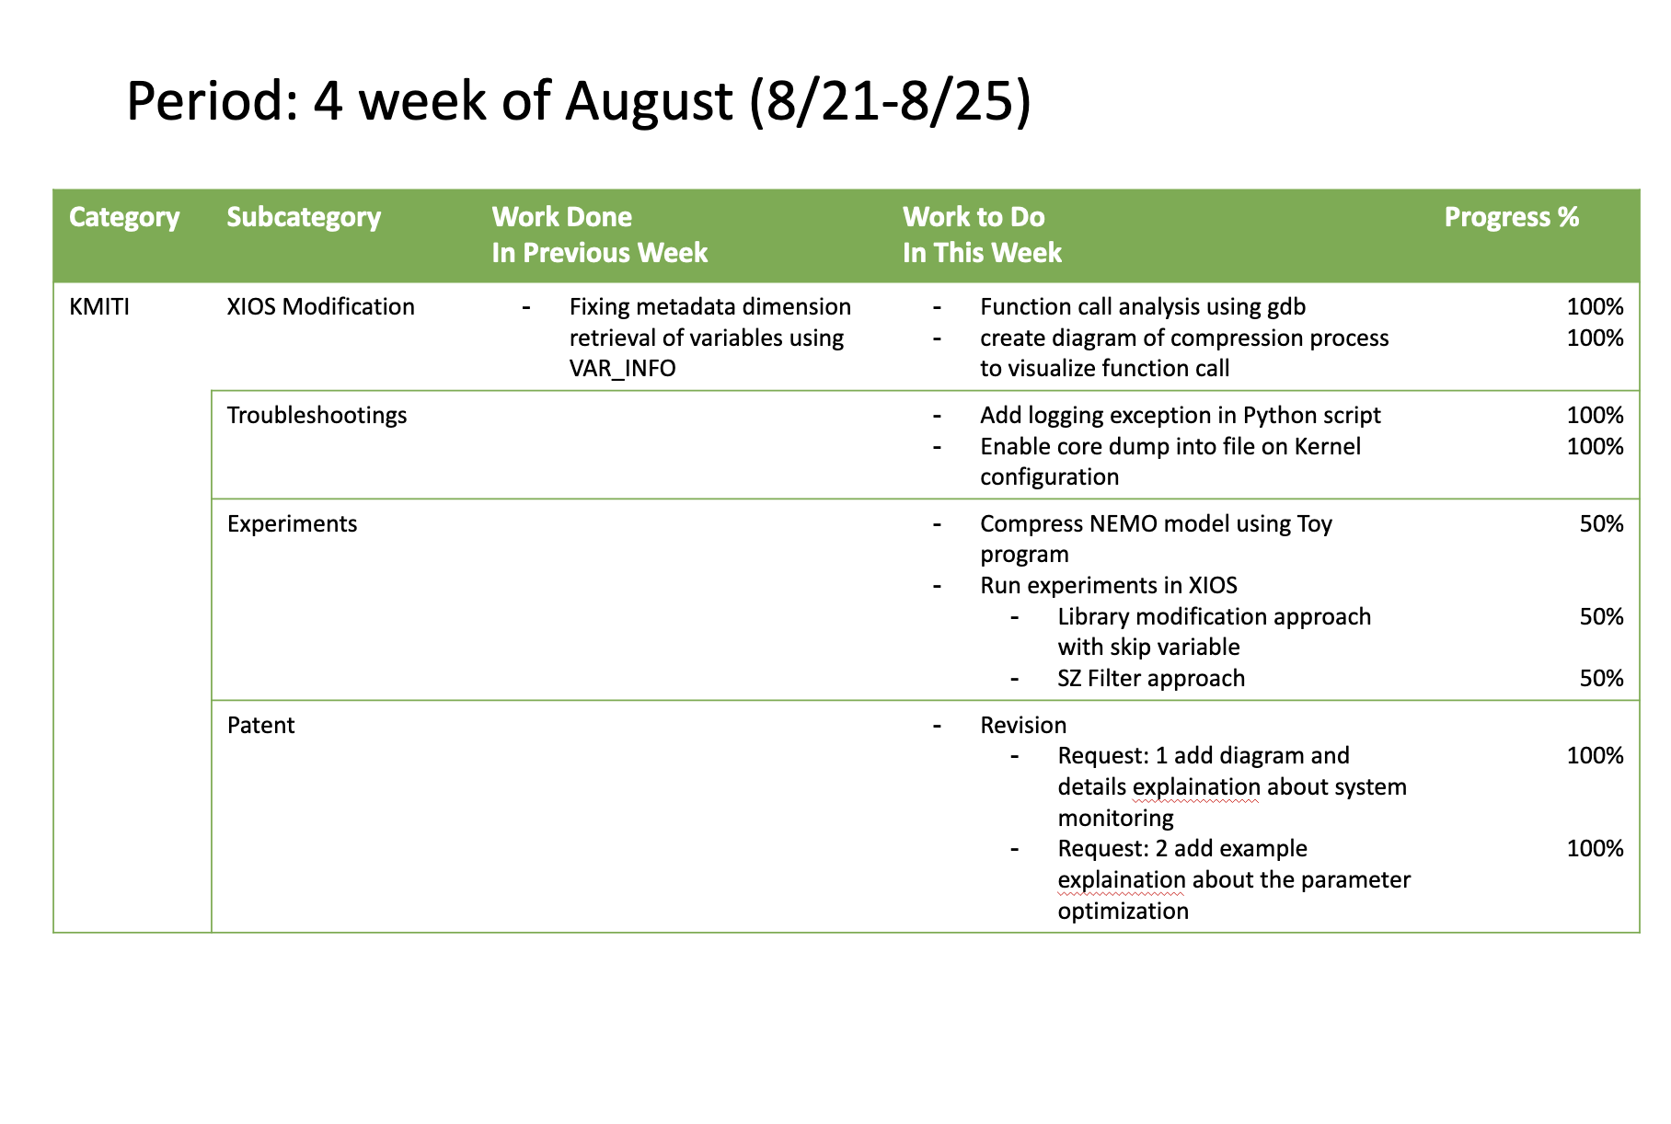
Weekly report

Slide 3
Summary of work this week
Two strategies were considered to apply SZ compression in Low GloSea6
Integrate the SZ Filter in XIOS Server by replacing the nc_def_var_deflate with the nc_def_var_filter function.
Modifying the underlying NetCDF4 and HDF5 library to trigger SZ compress when the nc_def_var_deflate is called.
The implementation of SZ compression has been partially successful for certain variables. Therefore, an additional feature has been added to skip the compression of unsupported variables in NEMO models.
Both strategies fail at the gsfc_ncdf_proc_m1_s01 task, several approaches have been tried to find the root caused
Add verbosity to log the exception message for the Python script in the gsfc_ncdf_proc_m1_s01 task.
Update the Linux kernel configuration to enable core dump into the file.

Slide 4
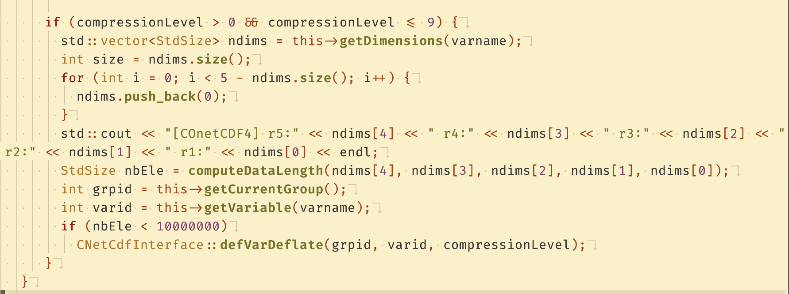
XIOS Modification
Add feature to skip compression for unsupported variables
The condition to skip SZ compression has been added to XIOS before calling the compression process
The condition using the computeDataLength function provided by the SZ library

Slide 5
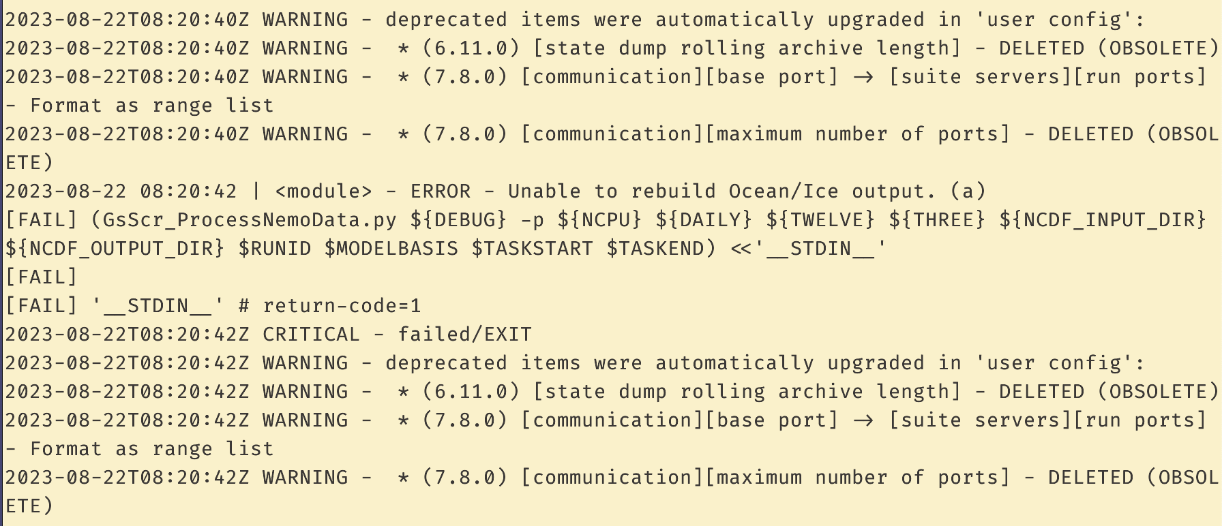
Troubleshooting
The gsfc_ncdf_proc_m1_s01 task logging information
The log for the task gsfc_ncdf_proc_m1_s01 doesn't provide much information about errors. Although logging was added to capture the actual exception messages, no new log entries have been recorded.

Slide 6
Troubleshooting
Updating Kernel configuration to enable core dump into file
Update the /proc/sys/kernel/core_pattern file to specify the directory for core dump storage.
Set the resource limit in /etc/security/limits.conf to define the maximum size of the generated core dump files. By default, the size is set to 0, which prevents core dumps from being generated.

Slide 7
Troubleshooting
Script Analysis at gsfc_ncdf_proc_m1_s01 task
The gsfc_ncdf_proc_m1_s01 task is defined to call Python script GsScr_ProcessNemoData.py
The GsScr_ProcessNemoData.py perform post processing on the model integration to combine the separate file into single model output file.
The script depends on internal Python script module, glosea.processing.netcdf

Slide 8
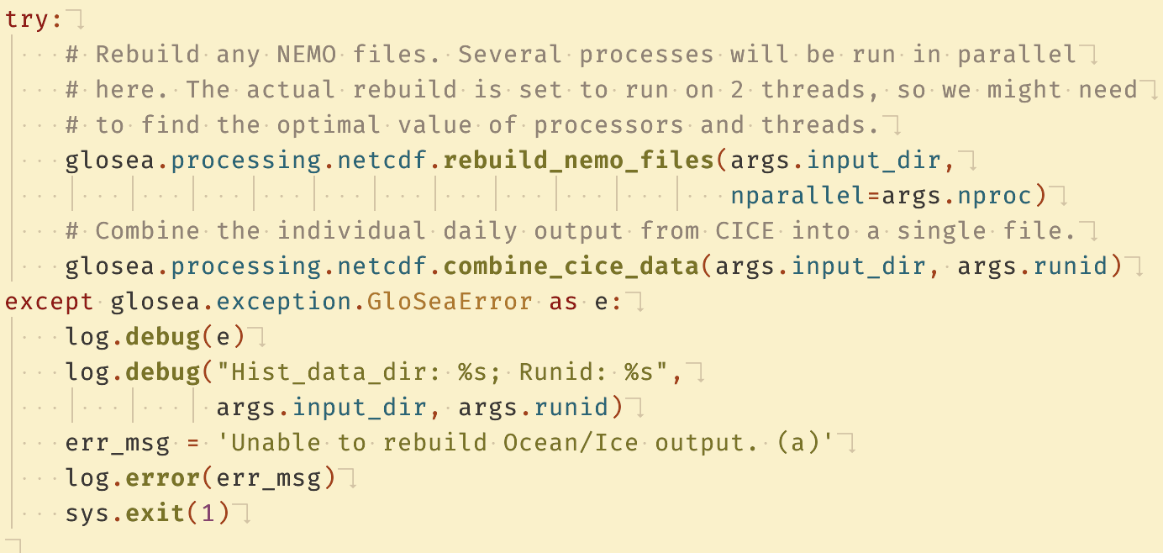
Troubleshooting
Script Analysis at gsfc_ncdf_proc_m1_s01 task
The module is designed to combine outputs from the NEMO and CICE models.

Slide 9
Troubleshooting
Script Analysis at gsfc_ncdf_proc_m1_s01 task
The module is defined at share/fcm_make_glosea/build/bin/glosea/processing/netcdf.py
The script calls the rebuild_nemo.exe program, which is written in Fortran and defined in the rebuild_nemo.f90 file.
A core dump for rebuild_nemo.exe can be generated in the /var/dumps directory. However, debugging symbols need to be enabled during the program's compilation. Further investigation is required to configure these symbols for debugging purposes.

Slide 10
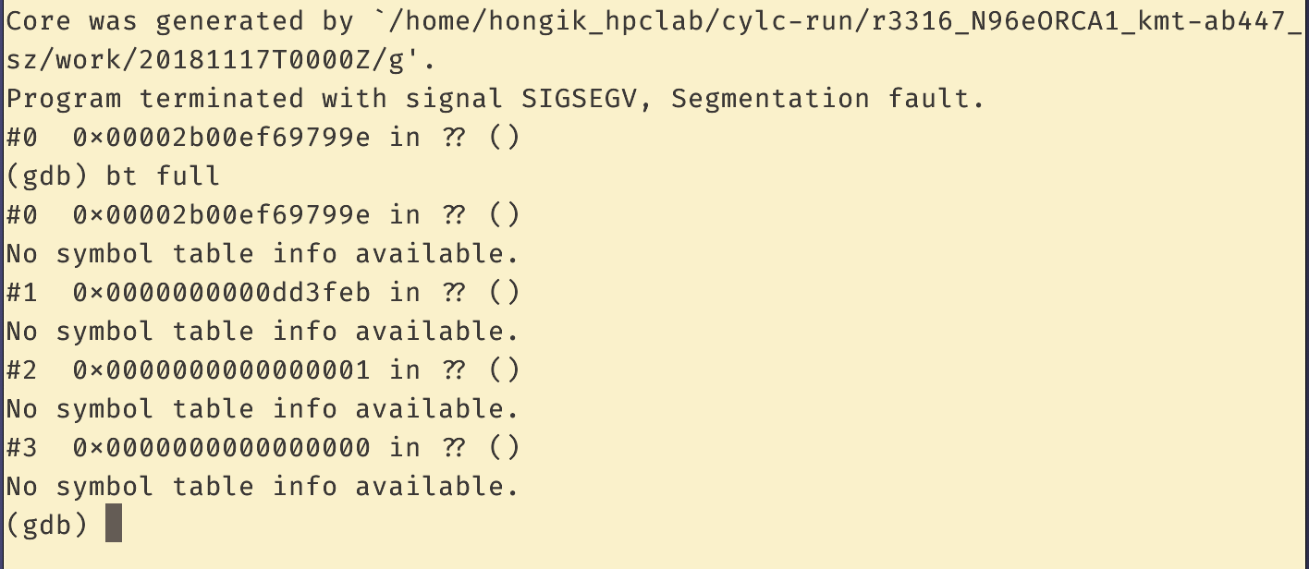
Troubleshooting
No symbol table available from rebuild_nemo.exe

Slide 11
Conclusion
An additional feature has been added to skip the compression of unsupported variables in NEMO models. However, the gsfc_ncdf_proc_m1_s01 task failed when merging the ocean model output.
The gsfc_ncdf_proc_m1_s01 task is designed to execute the Python script GsScr_ProcessNemoData.py for post-processing model integration data. This Python script relies on an internal module, glosea.processing.netcdf, and utilizes the Fortran program rebuild_nemo.exe to combine separate files into a single model output file.
While core dumps for debugging can be generated in the /var/dumps directory, it's crucial to enable debugging symbols at the time of rebuild_nemo.exe compilation for effective troubleshooting.

Slide 12
Action items
Find the configuration to enable symbols in rebuild_nemo.exe for debugging purposes.
File comparison analysis regarding the compression result.

